Slide 1

Tech Emergence - Seattle
Look out, Bay Area: Seattle rises to 2nd best tech city in the U.S., passing Washington D.C (geekwire: 7/2017)

Slide 2
Is Seattle an attractive location for us to move after Data Science BootCamp?

Slide 3
Will I find a job ?
Will I have friends my age ?
Can I afford a house?
Will my kids have fun over there?
How much will I make?
Will women earn as much as men?
Is economy doing well?
Will I be competitive in the job market ?
Can I get a job at Amazon ? Or should I compromise on Microsoft?
Will I find a spouse ?

Slide 4
Population changes in Seattle Metro
Will I have friends my age ?

Slide 5
How population changes are compared?
Data collected from US census Bureau population Estimates and Projections (2012 - 2017) program’s APIs (www.census.gov):
"2000-2010 Intercensals"https://api.census.gov/data/2000/pep/int_charagegroups
"Vintage 2017" - https://api.census.gov/data/2017/pep/charagegroups
Comparing Population changes by two categories
Age Groups
Gender
Bucketed population by 6 different Age groups.
Compared the population between Male and Female (Gender).
Population net changes in percentage (%) between years are used as metric in comparing Seattle Metro Vs US National changes.

Slide 6
How different age Groups’ population Net changed for periods (2001-2009) and (2009-2017) ?

Slide 7
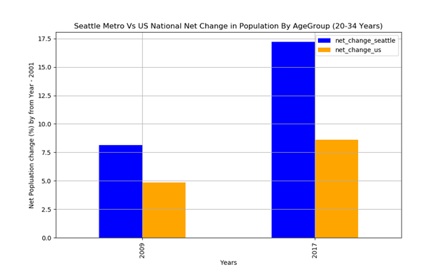
Age Group of 20 - 34 Years
Net population change (%) of Young Age Group (“20-34 Years”) is nearly double the time of US National from 2001-2009 and 2009 -2017.
Yayy!!!

Slide 8
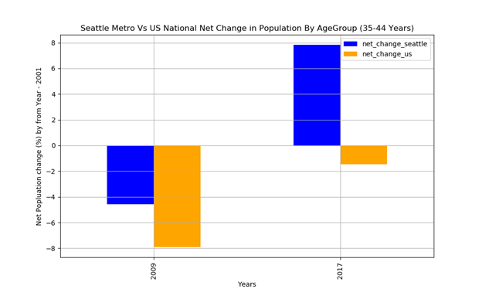
Age Group of 35 – 44 Years
Also for “35 – 44 Years” Age Group population Net population change (%) is increased about almost 12.40% compared 6.43% increase on US National level during 2009-2017 period. It means that Seattle attracts “35 – 44 Years” (Mid Age experienced) Age Group people to Seattle during 2009-2017.
Yayy!!!

Slide 9
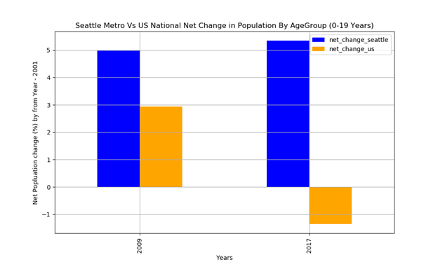
Age Group of 0 – 19 Years
Young Age Group (0 – 19 Years) Net population change (%) also increased almost 6% compared 1.5% decline in overall US. This may be due to increased population of Age Groups ( “20-34 Years” and “35 – 44 Years”)
Great !!!
My kids will find new friends too

Slide 10
How Gender population change in Seattle Metro Vs US National?

Slide 11
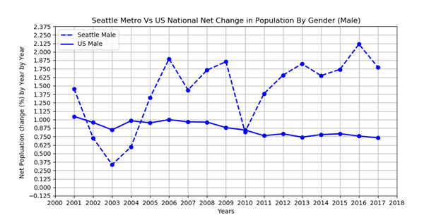
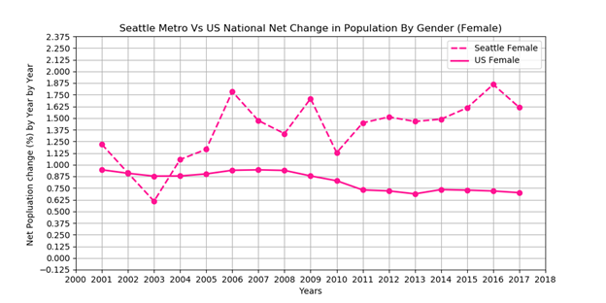
Gender Population Seattle Metro Vs US National
Seattle Metro population Net change (%) is always higher than the US population Net changes in most of the years from 2001 to 2017 for both sexes
Great !!!
I might find a spouse

Slide 12
Seattle Property Market Trends
Residential and Commercial Trends Over Time v. National Trends
Is economy doing well?
Will I be able to afford a house?

Slide 13
Seattle Property Market Trends: Seattle Office Market Inventory v. Vacancy
Looks like economy doing great!
Seen here is the effect of speculative construction in Seattle growing inventory; this has created a contra-phenomena of higher inventory being met counterintuitively by lower vacancy rates as firms are now rushing to gather Class-A and B office space in Seattle as the market continues to be saturated by Amazon and competitors such as Facebook, Google, Microsoft and many other mid/small-tech firms.
Source: CBRE Proprietary Database; Seattle Area Research

Slide 14
Seattle Property Market Trends: Commercial Rent Trends
2017/3-Present: Seattle +14.3% / Nationals +1.3%
2009-Present: Seattle +28.8% / Nationals +14.3%
Seattle market expansion on speculation has been fueled by the lack of many build-to-suit projects away from Amazon (and to a lesser extent mega-tech firms like Google and Microsoft) leading to a glut of office space as firms that tech firms traditionally don’t commit to large spaces for extended periods of time well in advance of occupancy date; this trend has been reversing as the market absorption rate continues to increase rapidly alongside Amazon’s mega-campus expansion in the East South Union neighborhood
Source: St. Louis Federal Reserve (FRED) Total Federal Reserve Economic Database / Source: CBRE Proprietary Database; Seattle Area Research

Slide 15
Seattle Property Market Trends: Home Price Trends
OMG!!!
So expensive
2014-Present: Seattle +56.7% / Nationals +29.3%
2000-Present: Seattle +147.7% / Nationals +106%
This data is indicative of the strong economic impact of technology-related growth in the Seattle economy, outpacing the nation as a whole. Rents have outpaced National trends by 27.4 percentage points (nearly double) national trends since the beginning of 2014.
Source: St. Louis Federal Reserve (FRED) Total Federal Reserve Economic Database

Slide 16
Seattle Property Market Trends: Rental Cost Trends
The rents are awful
2011-Present: Seattle +42.9% / Nationals +28.8%
2000-Present: Seattle +78.9% / Nationals +89.7%
As opposed to home price trends, which are indicative of a speculator bubble in home construction growing inventory even ahead of the rapid growth of the Seattle economy and population, rents have lagged behind home prices; this is often a classic example of a speculator bubble and over-investment.
Source: St. Louis Federal Reserve (FRED) Total Federal Reserve Economic Database

Slide 17
Educational Attainment

Slide 18
What skills are in demand?
Overview of Educational Attainment of the Washington State population.
Compare changes from 2010 to 2017
Focuses on population with Computer & Engineering Degrees.
Impact of demand on unemployment.
Data Source: US Census American Community Survey

Slide 19
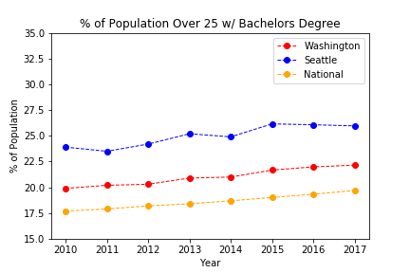
Educational Attainment 2010 - 2017
Oooh…
there is huge competition over there
Seattle has consistently held a higher percentage of the population with bachelor degrees or higher than the national average since 2010.
Rate of growth of Seattle has been equal to that of the U.S. overall.

Slide 20
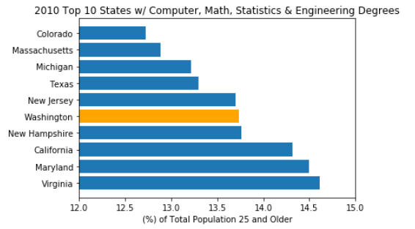
Washington State 2010 Ranking
2010 data as used as the baseline for comparison for changes.
In 2010 Washington State ranked 5th among all 50 States for the percentage of Computer, Science, & Engineering professionals.
Total Computer, Science, & Engineering professionals.
Est. 210K

Slide 21
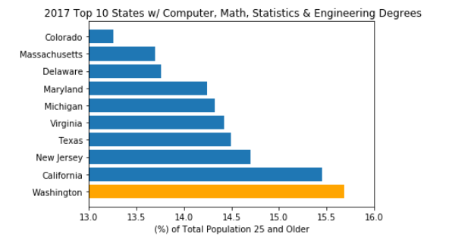
Washington State 2017 Ranking
By 2017 Washington State ranked 1st among all 50 States for the number of Computer, Science, & Engineering professionals.
Total Computer, Science, & Engineering professionals.
Est. 311K
Growth primarily driven by growth of tech companies in Seattle.
The job market keeps getting tougher and togher….

Slide 22
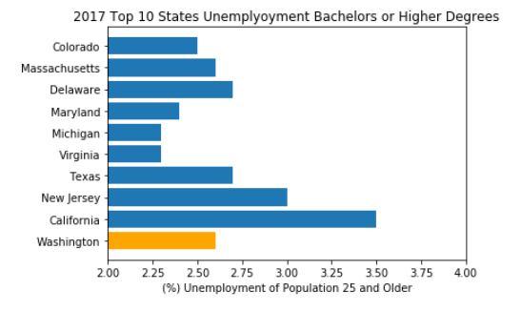
2017 Unemployment for Skilled Professional
Considered top 10 states with the highest percentage of Computer and Engineering Professionals.
Change since 2010
Unemployment 3.5%
Washington Unemployment Rate was 2.6% vs 3.5% for California.
Difference may be the result of:
Large difference in population
Large difference in demographics.

Slide 23
Job market changes in Seattle Metro
Will I find a job ?
How much will I make?

Slide 24
How job market changes are compared?
Data collected from US Occupational Employment Statistics: https://www.bls.gov/oes/
Topics in focus:
How the job market composition evolved in Seattle with focus on the IT sector
How the mean salaries evolved in Seattle with focus on the IT sector
A Long period (1999 - 2017) was chosen in order to be able to identify over time changes
Seattle data was compared to US national averages

Slide 25
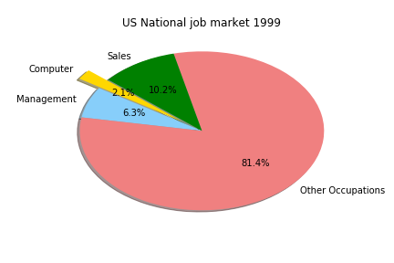
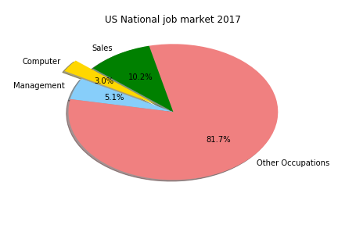
How US national job market changed over years
Computer Science jobs percentage of economy grew rapidly
Computer Science still represent a small percentage of economy

Slide 26
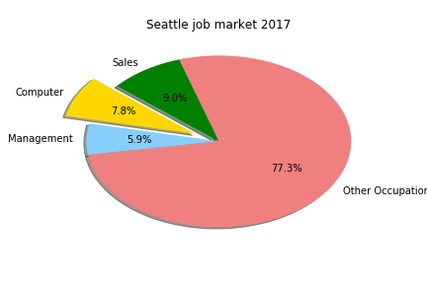
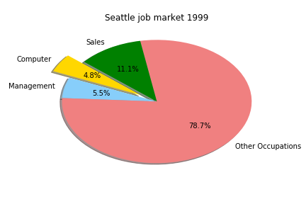
How Seattle job market changed over years
Lots of tech jobs!!!
Seattle has been a technology hub city for at least 20 years
The impact of technology sector grew significantly over the years

Slide 27
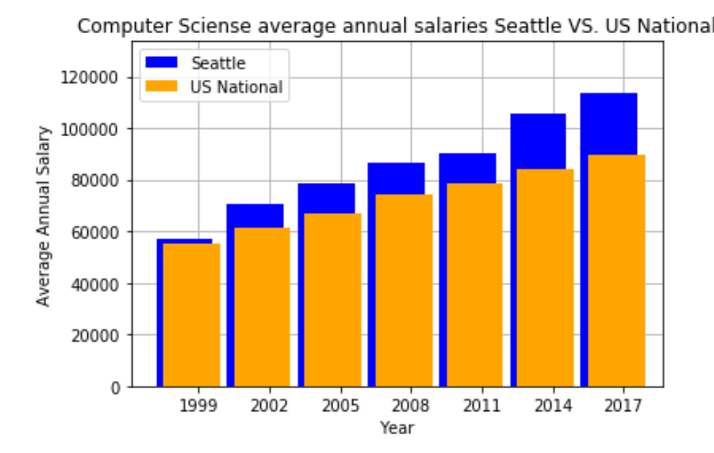
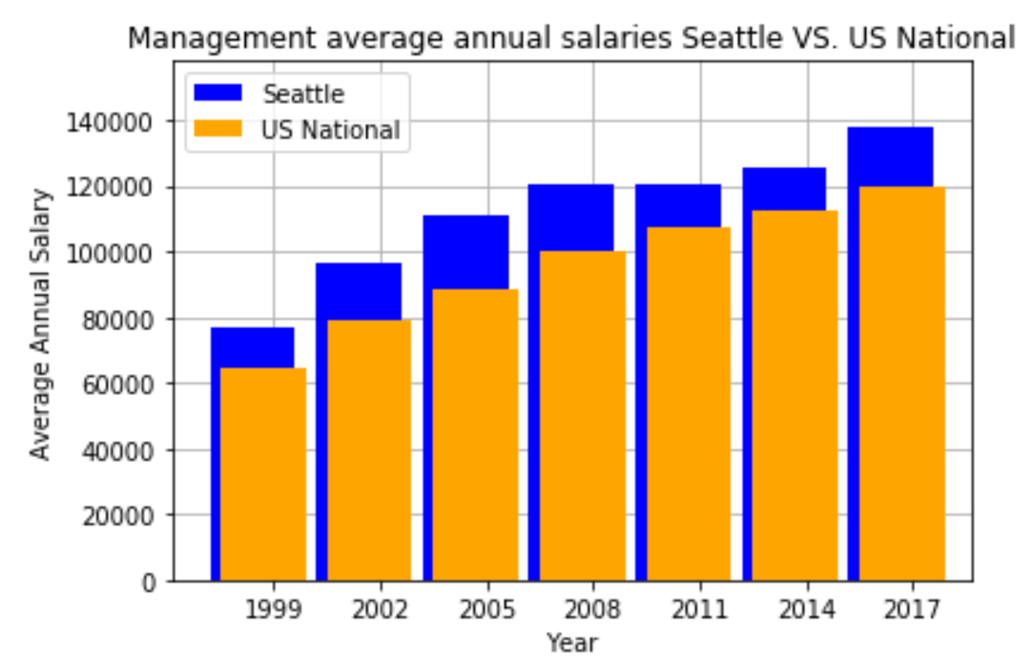
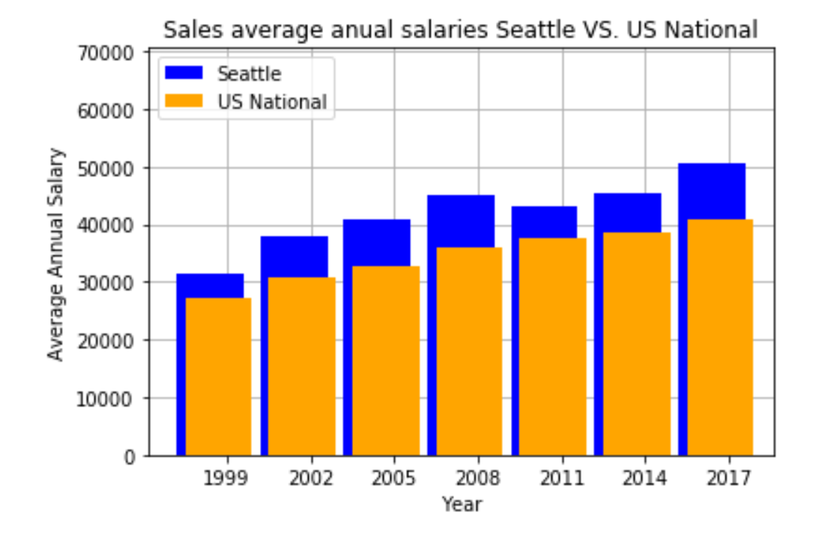
How average salaries changed over years
Employees in Seattle have been paid higher than in rest of US for at least 20 years
The technological “boom” caused the average annual salaries to grow faster in Seattle than US national
$$$$

Slide 28
Do Tech related occupations exhibit higher than average wage disparity?
Data sources:
Assumptions: State level data was only available for wage and gender data by occupation. Data for Tech was assumed in occupation categories of Sales, Management, and Computer & Math for this analyses
PUMA (USA Data), 3-YR est, 1-Yr est

Slide 29
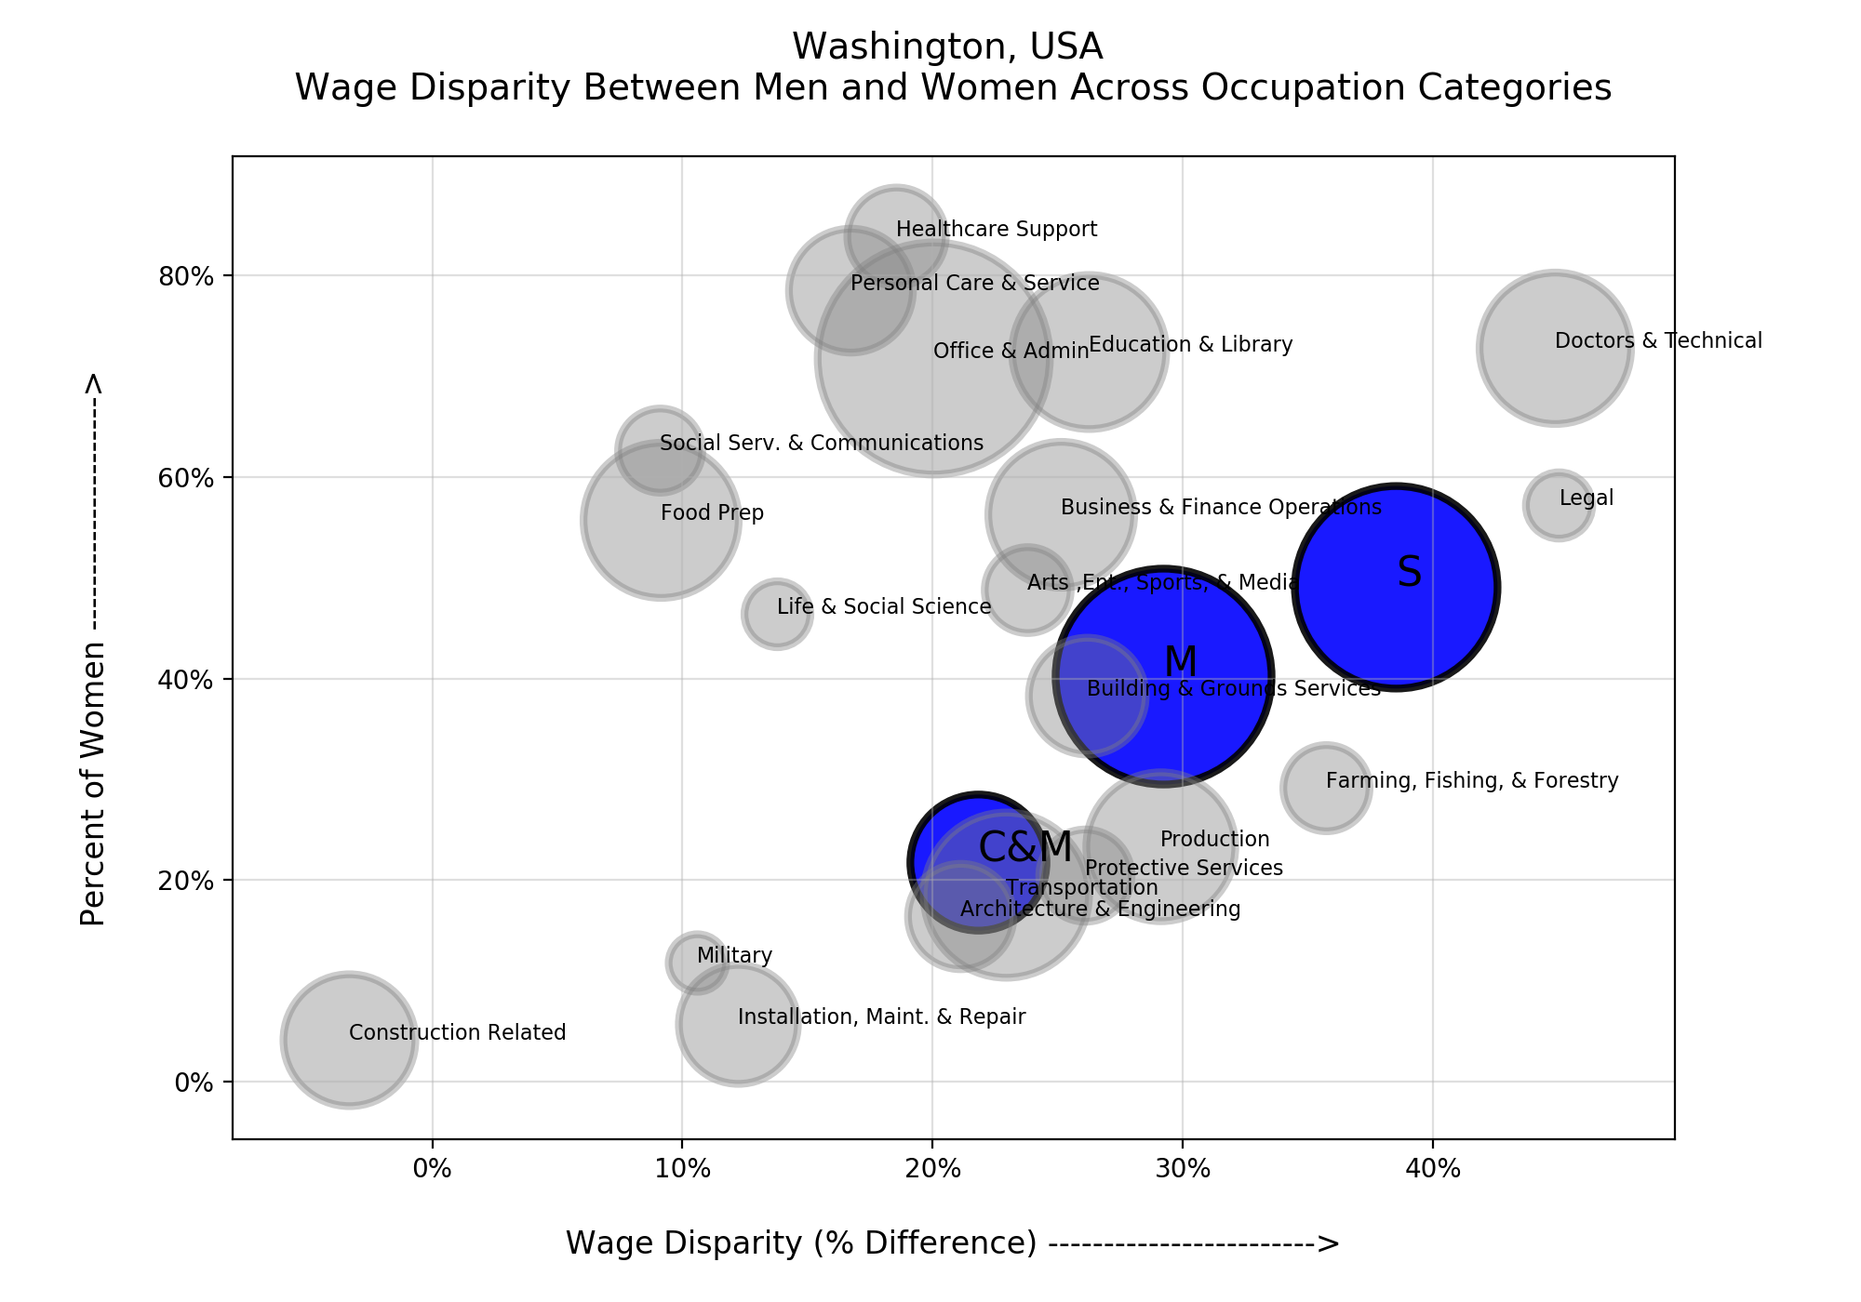
Tech Emergence - Seattle
Washington Wage disparity across occupations falls at 29%.
Computer & Math occupations, when compared against all other occupations falls below average in wage disparity (21%).
Sales, interestingly, represents 1 of the largest populations of occupations, has an above average percent of and displays above average wage disparity (39%)
It is good to be female in tech over there!

Slide 30
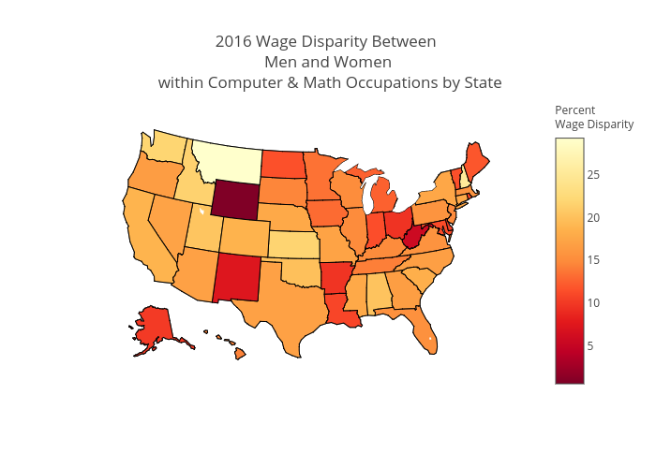
Tech Emergence - Seattle
Interesting, while Computer & Math occupations in Washington were below average in wage disparity when compared against all other occupations, Computer & Math wage disparity when compared against the US falls slightly above average, and higher than its Tech heavy states of California, New York and Maryland/DC
Guess what ? The person next to you might make more than you

Slide 31
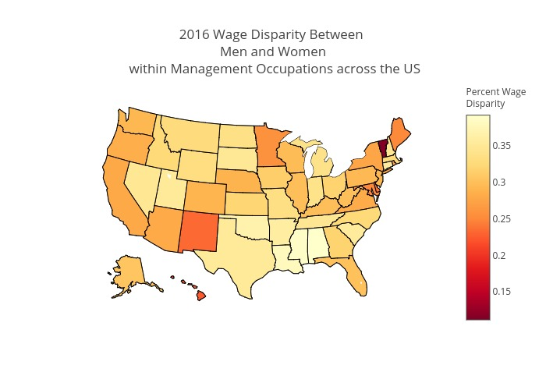
Tech Emergence - Seattle
Management occupation wage disparity in Washington fell in-line with the rest of the US, and in comparison with the tech heavy states of California and New York. The south noticeably shows the largest disparity in the US

Slide 32
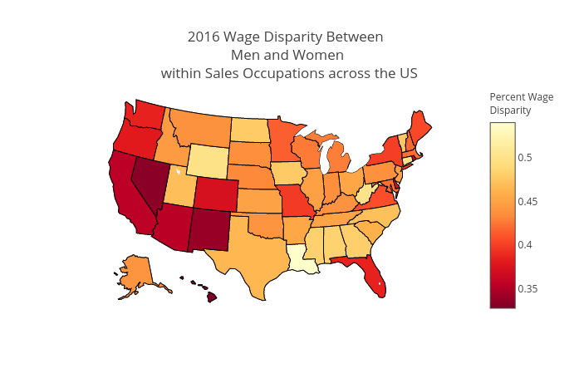
Tech Emergence - Seattle
Washington Sales occupation disparity is rather interesting. As you recall it was one of the highest disparity occupation categories in Washington at 39%, but Washington is actually one of the lowest wage disparity states within the US. And, California, a tech heavy states shows a lower wage disparity
If you love sales ? Washington is the place for you

Slide 33
Conclusion?
Let’s all go to Seattle !

Slide 34
Appendix:

Slide 35
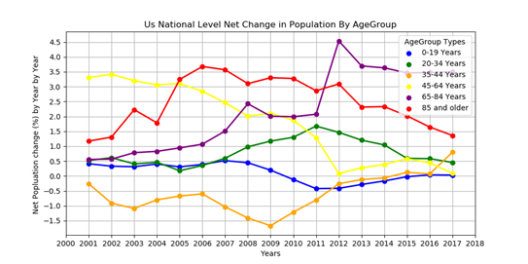
All Age Group Population changes in US National
Most of Age group population net changes (%) are stayed positive except 35-44 year Age group during from 2001 to 2013.

Slide 36
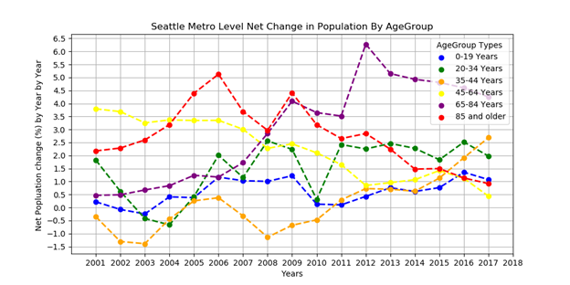
All Age Group Population changes in Seattle Metro
Most of Age group population net changes (%) are stayed positive except 35-44 year Age group during from 2001 to 2010.

Slide 37
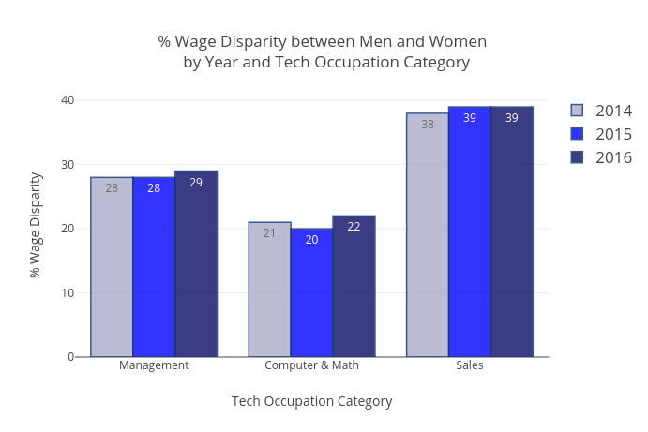
Tech Emergence - Seattle
When evaluating Tech related occupations over a 3-year period (2014-2016) there is little to no change over time
(NOTE: Given there is margin of error in, these slight changes are considered to be flat and negligible)

